Slide 1
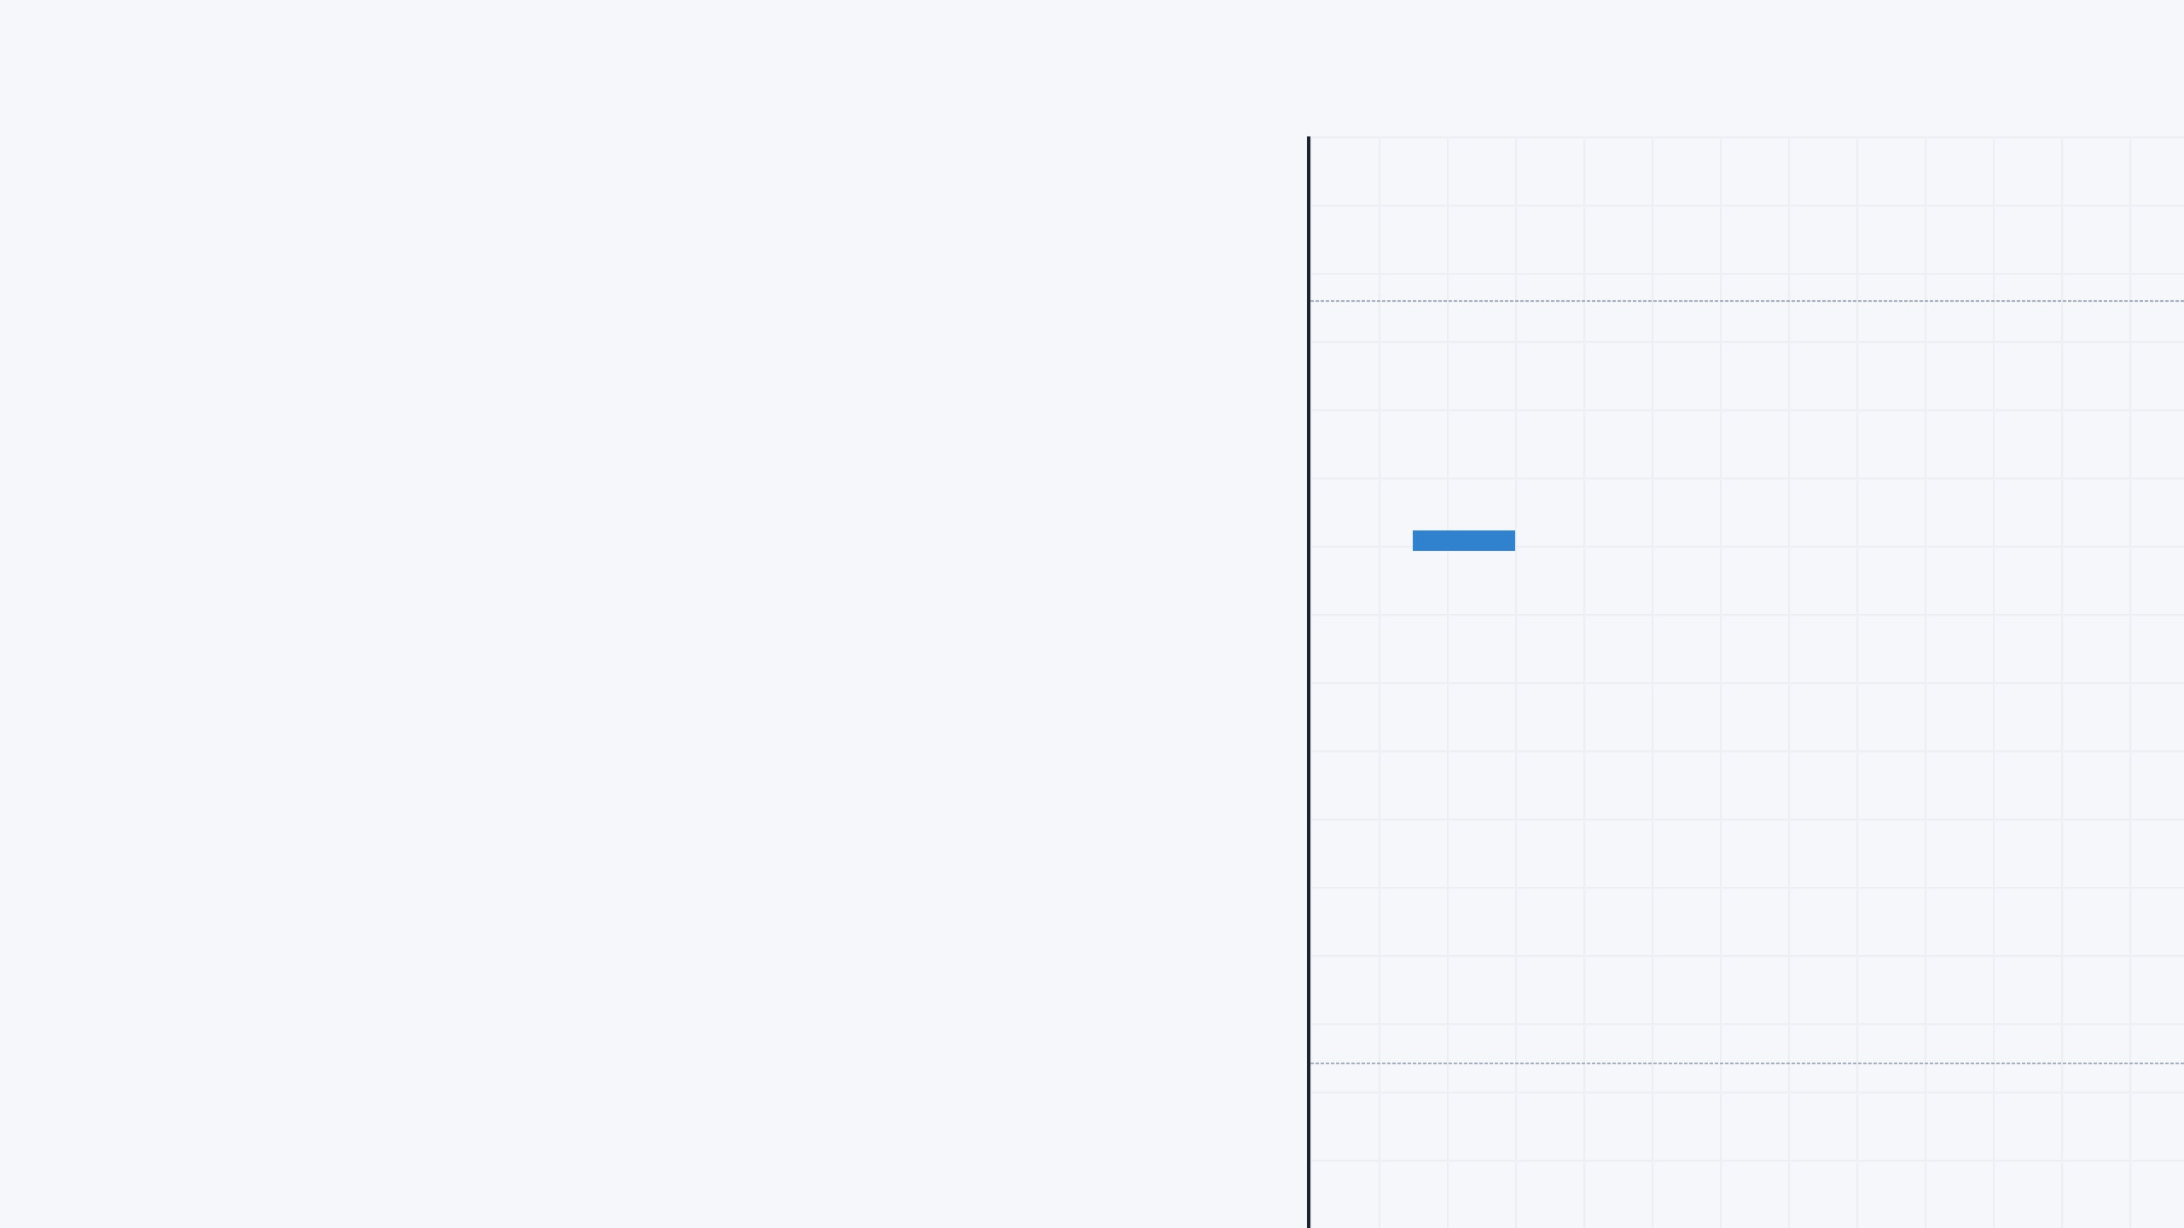
FEBRUARY 2026
MANUS AI RESEARCH
THE ADMINISTRATIVE WORK OF ZONAL EDUCATION OFFICES IN SRI LANKA
A COMPREHENSIVE OVERVIEW OF STRUCTURE, FUNCTIONS, AND REFORMS
BASED ON RESEARCH FROM MOE, ADB, WORLD BANK, UNESCO, AND NEC

Slide 2





SYSTEM OVERVIEW
02
SCALE & SCOPE
SRI LANKA'S PUBLIC EDUCATION SYSTEM
10,194
241,018
GOVERNMENT SCHOOLS
TEACHERS
Island-wide network
Public sector employees
99
4.1M
EDUCATION ZONES
Across 25 Districts & 9 Provinces
TOTAL STUDENTS
DEVOLVED ADMINISTRATION
Shared via 13th Amendment (1987)
National (MOE)
→
Provincial (PDE)
→
Zonal (ZEO)
→
Divisional (DEO)
→
School Level

Slide 3

ADMINISTRATIVE STRUCTURE
03
TIER 01 CENTRAL
Ministry of Education (MOE)
National policy formulation, exams, curriculum, SLEAS management
TIER 02 PROVINCIAL
Provincial Depts (PDE)
Provincial planning, budgeting, program implementation
FROM NATIONAL POLICY...
...TO CLASSROOM DELIVERY
TIER 03 ZONAL
Zonal Education Offices (ZEO)
Direct school administration, teacher management, quality supervision
TIER 04 DIVISIONAL
Divisional Offices (DEO)
Localized supervision, data collection, materials distribution
TIER 05 SCHOOL
Government Schools
Classroom delivery, student learning, field level operations

Slide 4

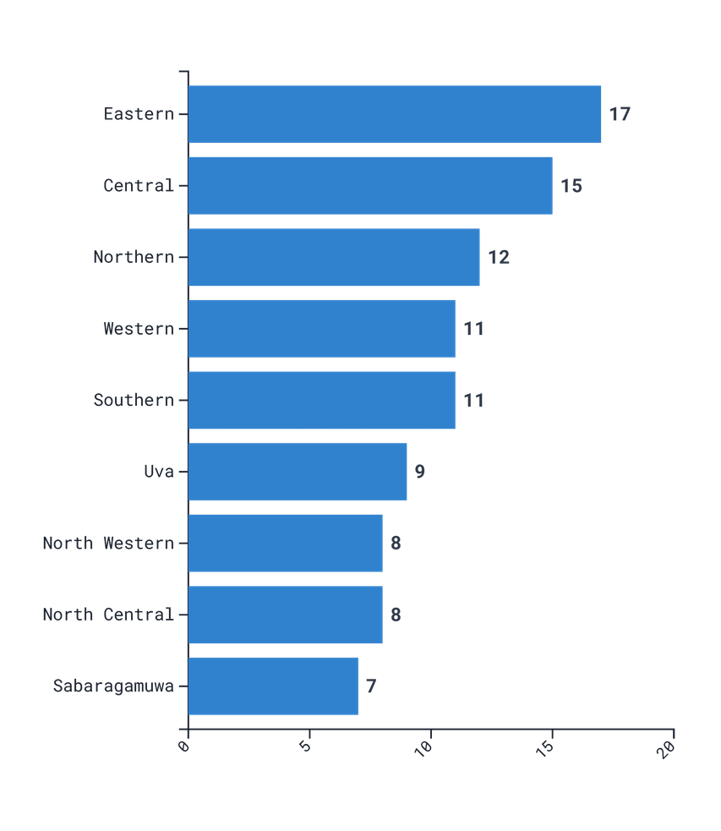
GEOGRAPHIC DISTRIBUTION
04
UNEVEN DISTRIBUTION ACROSS PROVINCES
NUMBER OF ZONES PER PROVINCE
PROVINCE
ZONES
SCHOOLS
STUDENTS
TEACHERS
Western
11
1,359
965,113
45,680
Central
15
1,519
547,996
34,013
Southern
11
1,112
531,695
30,272
Northern
12
997
241,085
17,838
Eastern
17
1,110
394,725
21,766
North Western
8
1,256
509,359
28,187
North Central
8
812
291,997
17,376
Uva
9
900
290,594
20,768
Sabaragamuwa
7
1,129
393,391
25,118
Source: School Census 2017, Ministry of Education

Slide 5






ORGANIZATIONAL STRUCTURE
05
INTERNAL STRUCTURE OF A ZONAL EDUCATION OFFICE
ZONAL DIRECTOR OF EDUCATION
Supported by Deputy Directors & Subject Specialists
Establishment & General Mgmt
Education Administration
Education Development
Planning Division
Finance Division
>
Appointments & Transfers
>
Student Admissions
>
Curriculum Implementation
>
Data Collection
>
Budget Management
>
Promotions
>
School Timetables
>
Teacher Training (SBTD)
>
Statistical Analysis
>
Salary Processing
>
Leave & Retirement
>
Student Discipline
>
School Improvement
>
Zonal Education Plans
>
Procurement
>
HR for all staff
>
Welfare Programs
>
Quality Assurance
>
Resource Mapping
>
Audit Compliance

Slide 6






CORE FUNCTIONS
06
ZEOS MANAGE THE ENTIRE LIFECYCLE OF A TEACHER'S CAREER
01
02
03
04
05
Recruitment &
Deployment
Transfers &
Promotions
Professional
Development
In-Service
Advisors (ISAs)
Record
Keeping
Identify vacancies and place new teachers
>
Process inter-school transfers
>
Facilitate in-service training
>
Specialized mentors based at zonal level
>
Maintain personal service files
>
Address imbalances (surplus vs. shortage)
>
Manage career promotions for teachers and principals
>
Implement School-Based Teacher Development (SBTD)
>
Deliver training and introduce reforms
>
Track salary increments and loan approvals
>
4,971 teachers expected to join the new ISA service

Slide 7





QUALITY ASSURANCE
07
MECH-01
MECH-02
FIELD SUPERVISION
ACCOUNTABILITY
ENSURING EDUCATIONAL QUALITY
Regular field visits by Zonal Directors, Deputy Directors, and In-Service Advisors (ISAs) to monitor curriculum implementation, teaching methodology, and classroom quality.
Zonal Directors hold the authority to take disciplinary action against underperforming principals, including replacement, ensuring leadership accountability at the school level.
MECH-03
MECH-04
Zonal Education Offices employ a multi-faceted approach to supervision, combining direct monitoring with data-driven strategy and school empowerment.
SCHOOL EMPOWERMENT
DATA STRATEGY
Implementation of the Programme for School Improvement (PSI). Empowering School Development Committees (SDCs) and Management Teams (SMTs) to drive local improvements.
Systematic collection and analysis of student assessment data to identify learning gaps. This data informs the development of targeted three-year zonal action plans.

Slide 8







STUDENT SERVICES & WELFARE
08
ZEOS ADMINISTER SCHOLARSHIPS, EXAMINATIONS, AND WELFARE PROGRAMS
ENROLLMENT & ADMISSIONS
PUBLIC EXAMINATIONS
SCHOLARSHIPS
Supervising and regulating the student admission process to ensure fairness, transparency, and adherence to national circulars.
Facilitating the local administration of national exams (G.C.E. O/L and A/L), coordinating centers, and ensuring security.
Managing the Presidential Scholarship Program distribution to underprivileged students.
116,000 AWARDED IN 2024
HEALTH & NUTRITION
TEXTBOOKS & UNIFORMS
CO-CURRICULAR ACTIVITIES
Implementing school feeding initiatives, nutritional programs, and drug prevention campaigns within the zone.
Logistics and distribution of free textbooks, school uniform materials, and other essential learning resources.
Coordinating zonal sports meets, academic competitions, field trips, and student leadership programs.

Slide 9


FINANCIAL ADMINISTRATION
09
THE FINANCE DIVISION MANAGES BUDGETS, SALARIES, AND RESOURCE ALLOCATION
CORE OPERATIONS
STRATEGIC ALLOCATION
FLEXIBLE FUNDING
Budget Management
Preparation and management of the annual zonal education budget, ensuring alignment with provincial and national allocations.
Education Quality Inputs (EQI)
Zonal officials distribute EQI funds to schools with discretionary power, allowing flexibility to meet specific local needs outside standard budget lines.
Salary Processing
Timely processing and disbursement of salaries for all teaching and non-teaching staff within the zone.
General Education Modernization Project
Procurement & Audit
$50 MILLION
Handling procurement of goods and services, managing tenders, and ensuring compliance with financial regulations and audits.
Additional financing approved in June 2025 to upgrade school facilities and improve teaching quality, specifically targeting underserved schools in rural and estate communities.
SUPPORTED BY WORLD BANK

Slide 10






SYSTEM CHALLENGES
10
KEY CHALLENGES FACING ZONAL EDUCATION OFFICES
ADMINISTRATIVE BURDEN
Large, remote zones struggle to provide equitable services. Example: Thenmarachchi Zone faces challenges due to vast geography.
LOGISTICS
CAPACITY CONSTRAINTS
Staff often lack formal training in educational planning. Shortages in human and physical resources are common.
RESOURCE
POLITICIZATION
"Extreme politicization" identified by NEC as a major impediment to system efficiency, affecting appointments and allocation.
GOVERNANCE
Despite their critical role, ZEOs face significant structural and operational hurdles that impede efficiency and equitable service delivery.
COORDINATION GAPS
Unclear delineation of powers between Central, Provincial, Zonal, and Divisional levels leads to duplication of efforts.
STRUCTURAL
INCOMPLETE AUTOMATION
The Education Management Information System (EMIS) is not fully automated, limiting data-driven decision-making capabilities.
TECHNICAL

Slide 11






REFORMS & MODERNIZATION
11
NATIONWIDE REFORMS AIM TO STRENGTHEN ZEO CAPACITY AND MODERNIZE THE SYSTEM
ONGOING
IMPLEMENTED
SHIFTING ROLE
Capacity Building
Standardization
School-Based Management
UNESCO-IIEP & World Bank partnership trained 120 officials. GPE program trained 80 planners in educational planning and management.
MOE Management & Quality Assurance Branch issued guidelines to standardize the structure and operations of all 99 ZEOs.
Moving ZEOs from direct control to a supportive monitoring role, empowering schools with greater autonomy via the PSI.
FUTURE OUTLOOK & MAJOR PROJECTS
TARGET: 2026
FUNDED
Curriculum Reform 2026
General Education Modernization
New national curriculum reforms are being prepared. ZEOs will be at the forefront of implementation, requiring significant coordination and teacher training efforts.
World Bank-funded project ($50M additional financing) to upgrade facilities and improve teaching quality, specifically targeting underserved schools in rural and estate sectors.

Slide 12

LEGAL FRAMEWORK
12
THE 13TH AMENDMENT: CONSTITUTIONAL BASIS FOR DECENTRALIZATION
CONSTITUTION OF SRI LANKA
Supreme Law
DEVOLUTION OF POWERS
NATIONAL OVERSIGHT
13TH AMENDMENT (1987)
Provincial Councils are empowered to develop and adopt their own education policies and statutes, provided they align with the national framework.
The National Education Commission (NEC) advises the President on national policy, ensuring coherence across all provinces.
PROVINCIAL COUNCILS
Devolved Authority
EDUCATION STATUTES
ADMINISTRATIVE SERVICE
POLITICAL CONTEXT
ZONAL ADMINISTRATION
The Sri Lanka Education Administrative Service (SLEAS) governs the appointment and career management of Zonal Directors and high-level officials.
Ongoing political debate continues regarding the effectiveness of the Provincial Council system and the extent of devolved powers.
Implementation Layer

Slide 13


CONCLUSION
13
THE LINCHPIN OF THE SYSTEM
Translating National Policy into Local Action
VITAL LINK
QUALITY DRIVER
FUTURE FOCUS
Zonal Education Offices are the essential bridge connecting the Ministry and Provincial Departments to the island's 10,194 schools, ensuring policy reaches the classroom.
Through direct supervision, teacher management, and resource allocation, ZEOs have the most immediate administrative impact on educational quality and student outcomes.
Strengthening ZEO capacity through modernization, training, and reduced politicization is synonymous with strengthening the entire Sri Lankan education system.

